Slide 1
Azure Training Day Migrating .NET applications to Azure

Slide 2

Presentation title
Let’s get Started!
Tell us what you think by completing our survey
Schedule a post-event session to address your specific requirements.
Speaker name
Title
Learn more : aka.ms/techdocs
Get certified : aka.ms/microsoftlearn
Sign up Developer newsletter: aka.ms/usdevconnect

Slide 3


About Me…
Peter De Tender – MCT, Azure MVP
CEO and Lead Technical Trainer of 007FFFLearning.com, +20 years IT experience, mainly datacenters and Microsoft Infrastructure background
Full-time in Azure since 2013 (Readiness & Architect)
Azure Advisor, Azure Certified Architect
Technical Writer, Book author, Courseware Creator
Living in Belgium, but traveling worldwide 90% of my time, helping larger Microsoft Partners, customers and Microsoft FTEs in learning about and using Azure, by providing workshops with passion
peter@pdtit.be
@pdtit @007FFFLearning
http://www.facebook.com/pdtit
http://www.linkedin.com/in/pdtit

Slide 4
Workshop delivery
For the technical trainers:
Each Module could be presented as a stand-alone module, although the full potential comes from delivering all modules
HOL are somehow depending on each other, starting from the IAC-lab, where students deploy the VM-based source environment, moving to WebApps, SQL PaaS, Docker, Azure Container Registry, running Azure Container Instance, and ultimately Azure Container Services with Kubernetes. (only labs that could be skipped are WebApps and AKS)
The HOL solution is based on a ASP.NET Core app « SimplCommerce » (Open Source), using SQL Database

Slide 5
Workshop delivery
For the technical trainers:
Whenever you detect any mistakes, issues, wrong wordings,… in presentations or LAB guides, please send an email to :
msdevseriessupport@007FFFLearning.com, subject « Azure Developer Series – Containers », so we can take care of this and fixing it immediately
Latest version of all content should be available on GitHub:
http://www.github.com/007FFFLearning/MSDevSeriesSupport

Slide 6
Web Application Migration
(.NET) web sites to Azure Web Apps
Peter De Tender
@pdtit @007FFFlearning

Slide 7
Key Objectives
What you will learn in this section
Introduction to Azure Web Apps
Deploying Azure Web Apps
Azure Web Apps Enterprise features
Web App Migration Scenarios
Intro to Azure Web Apps for Containers

Slide 8

Note regarding Demos
The demo slides are mainly used as a placeholder for in-person delivery of this workshop.
If you are watching this as a recorded session, know the demos are snippets from the full lab exercise related to this workshop module, and not fully-orchestrated demo scenarios.

Slide 9
Azure Web Apps: Introduction

Slide 10
Azure Application Services
A cloud app platform for delivering modern enterprise apps across cloud and mobile devices.
Delivered as an integrated offering that delivers features and capabilities from a number of existing Azure services
Enterprise Grade Apps
Fully Managed Platform
High Productivity Development

Slide 11






An end to end Application Platform
Apps
eCommerce
Digital global presence
Custom apps
LOB
API/Services/ISV
Services
Web apps
Web apps for Containers
Logic Apps
Azure
functions
API apps
Notification hubs
Mobile apps
Platform
App Service
Fully Managed Platform • Developer Experience • Enterprise Grade

Slide 12

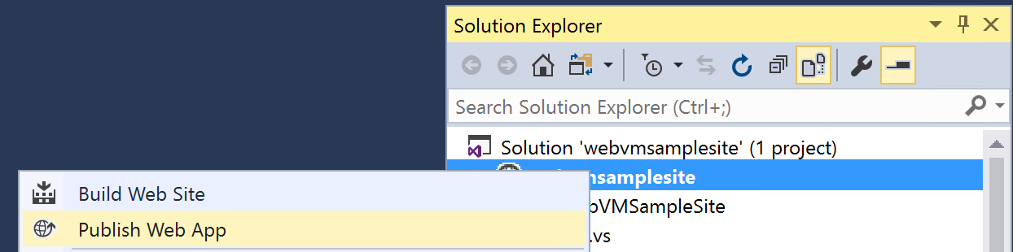


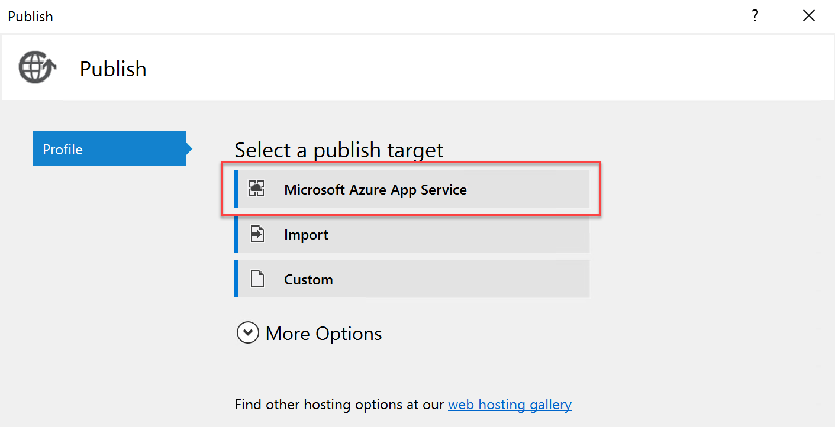
Deploying Code Directly to an Azure Web App Developer’s experience is not changing at all!
IIS VM
S ame
Dev
Web App

Slide 13

Deploying a Package to an Azure Web App
Similarly, push source code to multiple instances
Test
Package
Package
Dev
Dev
WebVM
Production

Slide 14
Deploying a Package to an Azure Web App
Similarly, push source code to multiple instances
Production
Package
Package
Production
Dev
WebVM
Production

Slide 15
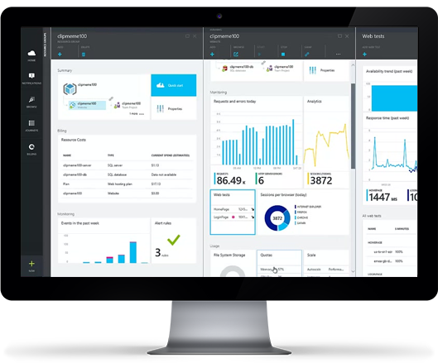
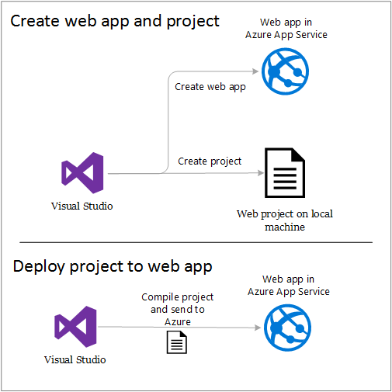
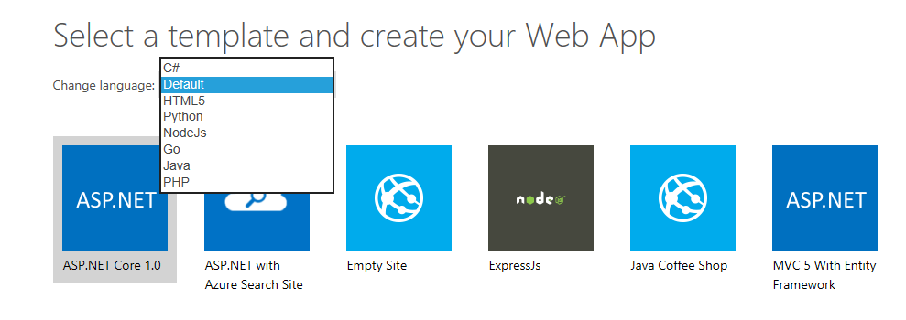
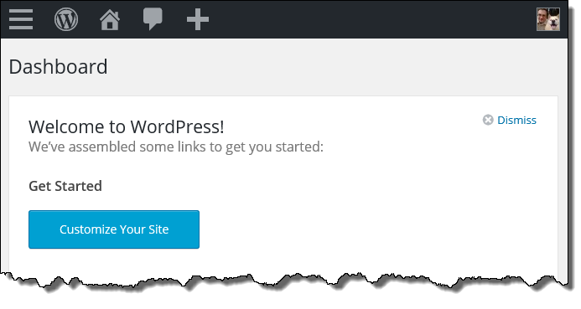
Supported Languages & Tools
Web Apps can be developed in virtually any development language and any toolset, including .NET, PHP, Node.js, Python, Java, Marketplace extensions. Web App development is built into Visual Studio 2015 and up for supported languages.

Slide 16
Deploying an Azure Web App from Visual Studio 201x

Slide 17
Azure Web Apps Killing Features
Why migrating workloads to Azure PaaS?
Azure Web Jobs
Deployment Slots
Auto Scaling
SSL
Custom Domains
Scale out
Different Pricing Tiers
Integrated Backup
App Insights
…

Slide 18
Azure Web Jobs
Host and schedule lightweight job on an existing website
Triggered once, by schedule or run continuously
Supporting:
batch (.exe/.cmd/.bat)
bash (.sh)
javascript (.js as node.js)
php (.php)
python (.py)
Dashboard Experience

Slide 19
Azure Web App Deployment Slots
Deploy and swap between different environments
My Web App
Dev/Test
Package
Package
Staging
Dev
WebVM
Production

Slide 20

Deployment Slot Resource Usage
By default, Deployment Slots point to the same App Service Plan as the source Web App
Staging slot
Application
Consumes
resources
Consumes resources
SCM site
App Service Plan
SCM site
for Staging slot
Consumes yet more resources
SCM site
for more slots
More slots

Slide 21
Deployment Slot Resource Usage
Best Practice: Allocate a different App Service Plan for each Deployment Slot
Consumes resources
Application
App Service Plan
SCM site
Staging slot
Consumes resources
App Service Plan
SCM site
for Staging slot
SCM site
for more slots
More slots
App Service Plan

Slide 22
Demo
Web App Deployment Slots

Slide 23

Per Site Scaling
By default: every app runs on every worker in an application service plan.
Apps
Application Service Plan

Slide 24
Per Site Scaling
Example Per Site Scaling
App #1: max of 1 instances
App #2: max of 2 instances
App #3: max of 5 instances
App #4: max of 10 instances
App #5: max of 25 instances
New setting from Resources.azure.com
Application Service Plan

Slide 25
Azure App Service Plan: The new Pv2 Plan
Guaranteeing you can scale into Pv2:
Create a new Resource Group (RG)
Create a new app + app service plan in the new RG
using your desired region
Select a Pv2 plan when creating app service plan
Then scale down to a lower pricing tier
You will always be able to scale back up in the future to Pv2
azure cli syntax:
az group create --location northeurope --name MyRG
az appservice plan create --resource-group MyRG --name MyAppServicePlan --sku P1V2

Slide 26
Demo
Web App Scaling / Autoscaling

Slide 27
Azure Web Apps: ASE

Slide 28

App Service Environment (ASE)
ASE is a deployment of the Azure App Service into a subnet of a customer’s Azure Virtual Network
ASE provides:
Network isolation for apps
Larger scale than multi-tenant
More powerful hosts
Ability to work with all VPN types

Slide 29


Azure App Service Environment services
Web apps
Web apps that scale with your business
Mobile apps
Build mobile apps for any device
Functions
Serverless event based development accelerator
API apps
Easily build and consume APIs in the cloud

Slide 30
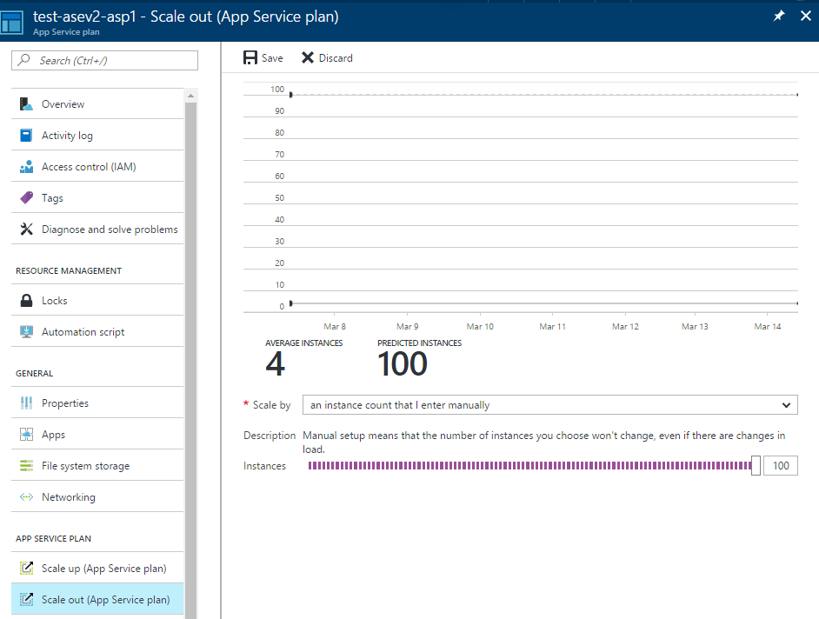
Scaling out App Service plans (ASPs) in ASE
In ASE you can scale to 100 ASP instances
That can be:
1 ASP with 100 instances,
100 ASPs with 1 instance each,
or anything in between.

Slide 31
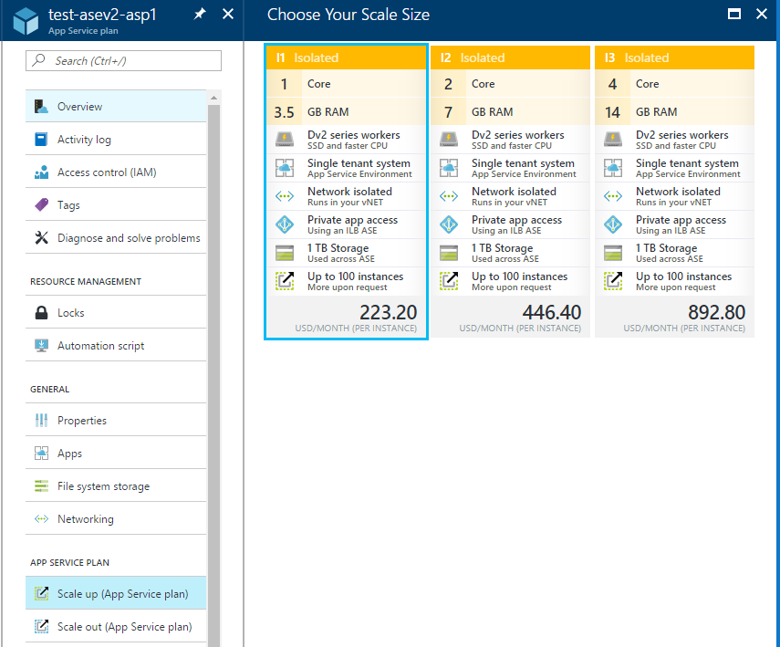
Isolated – Pricing plan just for ASE apps
One fee for the ASE plus Isolated App Service plan fees
ASE ownership fee does not change with the size of the ASE and covers all infrastructure including automatically scaled components
ASP fees let you pay for what you use
Prices vary between regions

Slide 32



ASE – High Level Network Overview
If you want private site access then create an ASE that uses an Internal Load Balancer instead of one with an external VIP
Because the apps are in the ASE inside the customer’s VNet, they can access resources that are also in the VNet
If the VNet is connected to an on premises network via a Site to Site or ExpressRoute VPN then they can access resources on premises
The apps in an ASE are exposed to the internet through a VIP
An ASE is a deployment of the Azure App Service into a subnet in a customer’s Azure Virtual Network
Internet
Azure Virtual Network
VIP
On Premises
App Service Environment
Site to Site or ExpressRoute VPN
ILB
subnet

Slide 33
Azure Web Apps for Containers

Slide 34
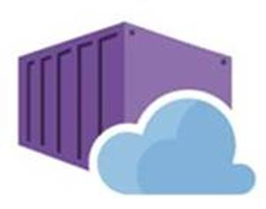





Web App now supports running Containers
Bring your code
Bring your container
.NET Core
Web App for Containers
Deploy to Azure in seconds
Scale easily on demand
Designed for your agile web development needs

Slide 35
Containers as Web Apps - Benefit
Why running Containers as Azure Web Apps
Treat the container as a web app
All common Azure Web App features are valid for Containers as well:
Backup
Monitoring
App Insights
App Service Plan (Although the plans are different for containers!)

Slide 36




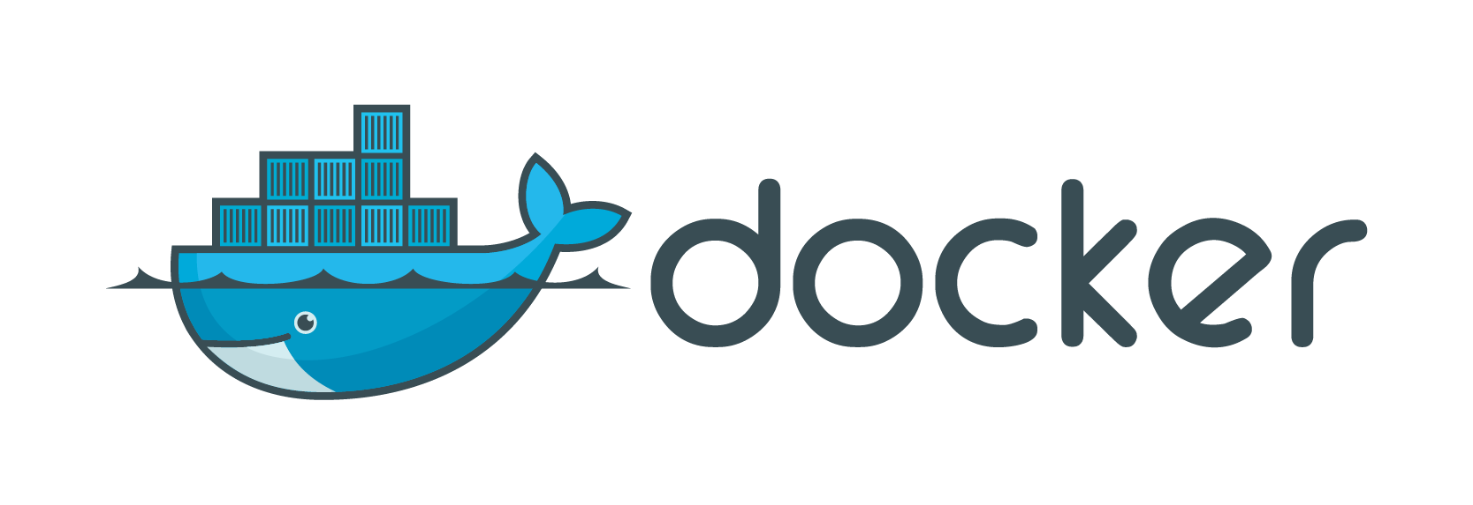
Azure App Service: Build and Deploy Options Deploying containers
Private container registry
Azure Pipelines
Docker push
Pulls container image
Azure Container Registry
Runnable web app
in Azure App Service
Docker build:
Docker Hub build
Docker build on dev machine
Etc…
Docker Hub

Slide 37

Web app for containers
High productivity development
Fully managed platform
Enterprise-grade apps
Deployment
with ease
CI/CD build
and deploy
Built-in auto scale and load balancing
High availability with auto-patching
Global data center footprint
Private registry
support
Testing in production
Staged deployment
with slots
Monitoring
and diagnosis
Backup and recovery
AAD integrated
Secure + compliant

Slide 38
Windows Container Support Public Preview
Windows Server 2019 Host Support
Smaller containers, higher density of apps, faster pull and start times
Server Core Containers reduced by over 60% from WS2016LTSC
Take advantage of improvements not available on WS2016
Key Scenarios
Lift and Shift to PaaS
Applications which have dependencies
Applications blocked by traditional App Service Sandbox
Data center migration
Capabilities
Available in six regions globally
PowerShell and CLI Support
Bring Your Own Storage – Azure Files
Application layers
Customization layers
Base OS—layer

Slide 39
Demo
Azure WebApps for Containers

Slide 40
App Service Migration

Slide 41
Azure Web App Migration Assistant
Check your applications for Azure Web App Compatibility, before migrating
Free tool (Former “Movemetothecloud.net”
Runs Assessment of .NET, Node.JS, Java,…
Also supports running the actual migration from source to Azure Web App

Slide 42
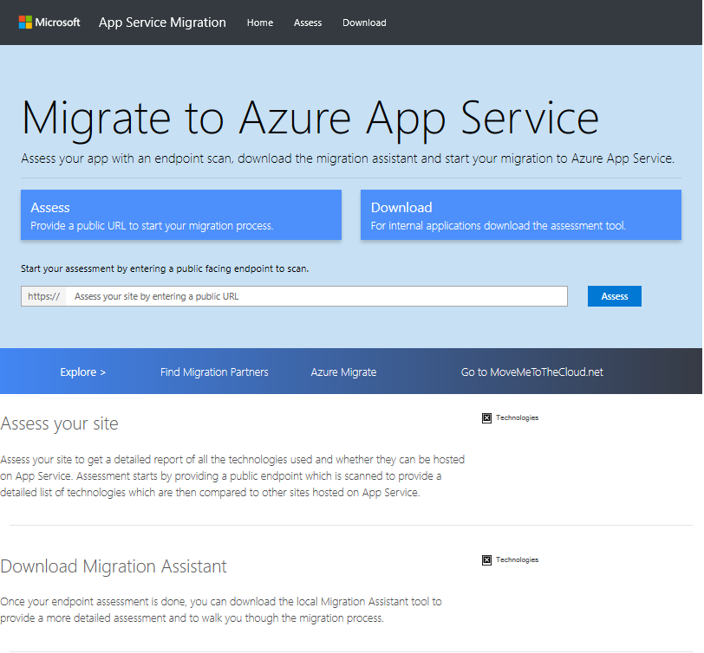

Application Migration Assistant
Assess
Quickly and easily determine if a public endpoint is a good candidate for App Service.
Migrate
Download the tool to do a detailed assessment of your ASP.NET site and then use the tool to quickly and easily migrate your content and config to Azure App Service.
Optimize
Dedicated migration experience in the portal analyzes your apps and provides detailed configuration guidance.
App Service
Migration Assistant
Move your ASP.NET App or Site to Azure app service with the help of the Azure App Service Migration Assistant.
https://appmigration.microsoft.com/

Slide 43
Demo
Running Azure Web App Migration using App Service Migration Assistant

Slide 44
Section Take-Aways
Microsoft offers the Microsoft Cloud Adoption Framework, to assist in the end-to-end adoption of Azure public cloud
Azure Migrate provides the right tools to help customers from assessment to migration, using Microsoft tools, or integrated with 3rd party tools
Azure Migrate = Virtual Machine Assessment + Migration Azure Migrate = (SQL) Database Assessment + Migration Azure Migrate = App Services Assessment + Migration

Slide 45
Questions
Landing
Spot
“…If you want good answers, ask better questions…”
© Randy Glasbergen

Slide 46
Next Module…
Running Containerized Apps in Azure
@pdtit @007FFFlearning

Slide 47
Thank You

